Slide 1
Machine Learning
University of Calabria
Dimes - Machine Learning Course
« Features Extraction & Red Wine Quality Prediction »
Nicola Corea

Slide 2
Index
In these presentation the following topics are discussed
in detail:
Introduction , Red Wine Quality Predictions
Problem Analysis , Dataset Analysis
Proposed Solution , Machine Learning Algorithms adopted
Sperimental Results
Conclusions

Slide 3
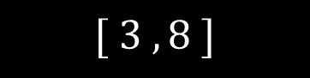
Introduction
The problem considered is the Red Wine Quality Prediction Problem. Thanks to the work of P. Cortez , A. Cerdeira the dataset used for training our classifiers (from UCI Repository) contains 1599 examples of the Vinho Verde red wine . The wines are classified on the base of several wine’s characteristics
like:
Fixed Acidity
Volatile Acidity
Citric Acid
The quality of the red wine based on the values of 11 characteristics , is represented by an integer varying in the following interval
$$[ 3 , 8 ]$$

Slide 4
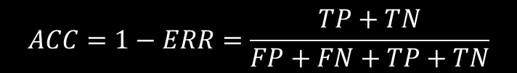
Performance Evaluation
The performance of our classifiers is done in term of the Accuracy.
1
0
Said
$$ERR=\frac{FP+FN}{FP+FN+TP+TN}$$
TP
FP
1
Predicted Values
the classification error , the accuracy is defined as
FN
TN
0
$$ACC=1−ERR=\frac{TP+TN}{FP+FN+TP+TN}$$
Real Values
In figure the confusion matrix.

Slide 5
Model Training
So the problem is to predict the Red Wine Quality on base of the wine’s characteristics. For that purposes , we train three different classifiers to compare the result obtained , always in term of accuracy.
In particular the classifiers that we have choosen are:
KNN (K-Nearest-Neighbors) lazy classifier.
SVM (Support Vector Machine) Kernel Method extension.
DTC (Decision Tree Classifier) Entropy as Inpurity Measure.
Note that we have not used for example Linear Regression. It is possible to proof by empiric results that this kind of classifier also extended with OvA (OvRs) techniques , is not a good solution for Red Wine Quality Prediction problem.

Slide 6
First Step : Preelaborations
The data preelaboration is a very important step in machine learning algorithm training. Remember that preelaborations improve the convergence of the train algorithms.
In the sequel :
How to solve missing data problem?
Is important to do a Cross Validation?
Why we need Standardization?

Slide 7
Missing Data Problem
May append that values of characteristics is not known for some examples , like in this case.
The problem born ‘cause when we load the dataset as Pandas Dataframe
# loading dataset from machine learning repositories
URL = os.path.join('https://archive.ics.uci.edu','ml','machine-learning-databases','wine-quality','winequality-red.csv')
# saving as Pandas Dataframe
df_wine = pd.read_csv(URL,encoding='utf8',sep=';',quotechar='*')
null values for some characteristics are replace with the mark NAN (Not a Number).
We have solved this problem by replacing NAN values by the mean value of each feature.
# solve problem relative to missing data
pd.fillna(‘mean’)

Slide 8
Cross Validation
Before leaving a model free to operate in the real world , we need to verify its accuracy on data that it never see.
To this end , we have splitted the data in two subset:
a training dataset , in the sequel X_train.
a validation dataset , in the sequel X_test.
# cross validation method for testing model
X_train,X_test,y_train,y_test = train_test_split(X,y,test_size=0.3,random_state=1,stratify=y)
We can use these two dataset to select the best hyperparameters for our model , and so analyze the ratio
« Bias , Variance »

Slide 9
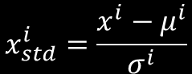
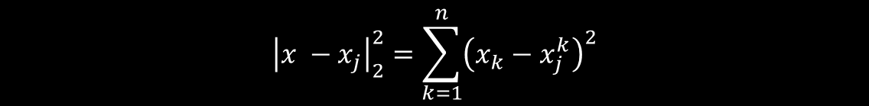
Standardization
The most important step in the preprocessing phase is the features standardization.
To understand why , think how KNN algorithm works
$${\left|x −x_{j}\right|}_{2}^{2}=\sum_{k=1}^{n}{{\left(x_{k}−x_{j}^{k}\right)}^{2}}$$
as we can see , if we not use standardization , the algorithm doesn’t work good , ‘cause the distances in the previous expression are most influenced by the greatest features values
So , it is important to standardize the data before training
$$x_{std}^{i}=\frac{x^{i}−μ^{i}}{σ^{i}}$$
After this kind of operation our data can be interpreted as realization of a normal multivariate distribution.

Slide 10
for the case taken in consideration , we report some charateristic’s properties , like max – min value mean etc..
 | Fixed Acidity | Volatile Acidity | Citric Acid | Residual Sugar
mean | 8,3196 | 0,5278 | 0,2709 | 2,5388
std | 1,7410 | 0,1790 | 0,1948 | 1,4099
Min | 4,6000 | 0,1200 | 0,0000 | 0,9000
Max | 15,9000 | 1,5800 | 1,0000 | 15,5000
as we can see features like Fixed Acidity and Residual Sugar are dominant.
# standardization
sc = StandardScaler()
X_train_std = sc.fit_transform(X_train)
X_test_std = sc.transform(X_test)

Slide 11
Primal Results
After the preprocessing task , we are ready to train our classifier to predict , on the base of feature values , the red wine quality.
As explained before , we’ll refer to three different classifier for this kind of problem:
KNN (K-Nearest-Neighbors) classifier.
SVM (Support-Vector-Machine) Kernel Function classifier.
DTC (Decision-Tree-Classifier) with Entropy as Impurity Measure.
In the sequel the results obtained both in training and validation phase.
Classifier | Training Accuracy | Validation Accuracy
SVM | 0,94 | 0,69
KNN | 0,66 | 0,58
DCC | 0,67 | 0,59

Slide 12
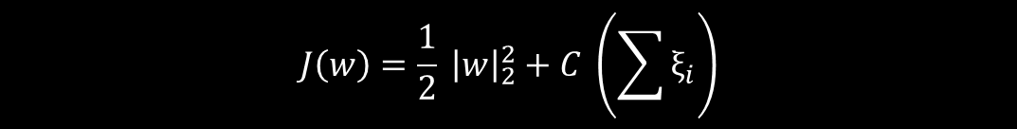
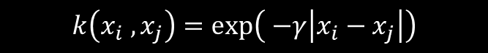
As we can see from the previous table , the best classifier both in training and validation phase , for this kind of problem is the SVM Kernel Classifier.
The best hyperplane is choosen according to
$$J\left(w\right)=\frac{1}{2} {\left|w\right|}_{2}^{2}+C \left(\sum{ξ_{i}}\right)$$
with $C=10,0$ and as kernel function for features augmentation , we’ve choosen the RBF function
$$k\left(x_{i} , x_{j}\right)=\exp\left( −γ\left|x_{i}−x_{j}\right|\right)$$
with $γ=0,25.$ The hyperparameters have been choosen in manner to prevent the model from over and underfitting problem.

Slide 13
As we have seen before , also by using SVM classifier , the performance of our classifier are lower than 70% , in term of accuracy.
In a first moment , we can think that ensemble techniques like majority voting , bagging or boosting , can improve the accuracy.
Ensemble | Training Accuracy | Validation Accuracy
Majority Voting | 0,79 | 0,63
Bagging | 0,99 | 0,68
AdaBoosting | 0,56 | 0,54
In each ensemble techniques , the number of classifier is not greater than 25 , due the large number of features representing the data.
But , as we can see , also by using ensemble , the results are lower than 70% in term of accuracy.

Slide 14
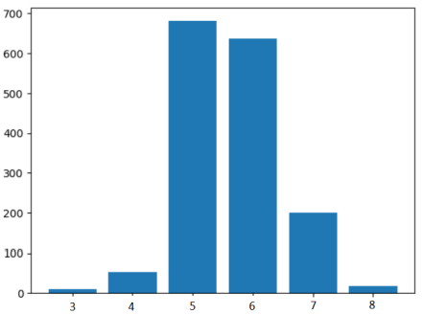
Problem Analysis
A first reason of these lower results can be found in not a uniform distribution of the examples for class.
Infact as we can see from the figure , the examples are major distributed over the classes 5 , 6.
But , if we analyze the content of the dataset , the problem of these lower results could be due to the fact that examples from different classes share the same values of the most significant features.

Slide 15
Proposed Solution
The idea is to make a second preprocessing phase. In particular to solve the problem due to the fact that some examples belonging to different classes share the most important features values, the proposed solution consists in a redefinition of the class label.
Label | Wine Quality
0 | Low
1 | Medium
2 | High
After this label change , we pass from a initial space of 6 class labels to a new space of 3 class label whose values correspond to different wine’s quality.
But the problem that remains to solve is : « How to perform this change of labels? »

Slide 16
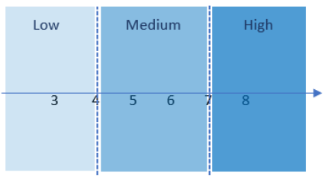
Labels Transformation
The labels transformation for each example in the dataset is done according to the following strategy
As we can see from the previous figure , the example whose label belongs to the interval $(−∞ , 4]$ have been valuated as Low Quality Wine , labels in the interval $[5,7]$ correspong to Medium Quality , and at the end labels in the class $\left[8 , +∞\right)$ correspond to an High Quality of the Vinho Verde wine.

Slide 17
After performed this change of labels , we can train our classifier and compare the result with those obtained without a second preprocessing phase.
Classifier | Training Accuracy | Validation Accuracy
SVM | 0,99 | 0,95
DTC | 0,96 | 0,94
KNN | 0,95 | 0,95
As we can see from the previous table , after this label modification , the results in term of accuracy are increased up to 20-30% respet to the previous accuracy.
But , the previous classifiers have been trained considering all the 11 features , so the model should result too complex.

Slide 18
To reduce the model complexity , exist different solutions to the problem of dimensionality reduction.
The idea behind the dimensionality reduction is the projection of the data into a subspace with a dimension lower than the feaure initial dimensional space.
The aim of dimensionality reduction techniques is to represent the data with a lower number of features and at the same time mantaine the major informative gain carried out by the data.
In pratiche exist both selection and extraction method for dimensionality reduction:
SBS (Sequential Backward Selection) as selection method.
PCA (Principal Component Analysis) as extraction method.
In the sequel we present in detail these two techniques and we analyze the effects of applying these methods to Red Wine Quality Prediction.

Slide 19
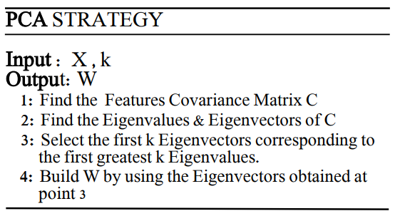
PCA (Principal Components Analysis)
Without going more in detail , the PCA is a linear transformation with the aim to represent data into a new features space with a dimension that is lower than previous one. This allows us to reduce the models complexity.
We present briefly the algorithm.

Slide 20
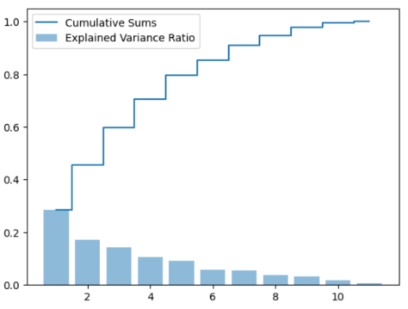
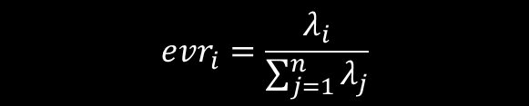
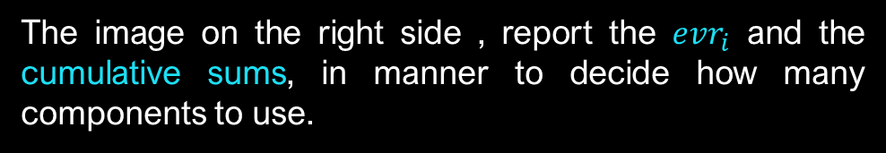
But remains the problem to select the number of features of the new subspace , or , that is the same , to decide the number of principal components to use.
To this end , we introduce the concept of « explained variance ratios »
$$evr_{i}=\frac{λ_{i}}{\sum_{j=1}^{n}{λ_{j}}}$$
The image on the right side , report the $evr_{i}$ and the cumulative sums, in manner to decide how many components to use.
As we can see selecting the first 4 components , we have over than 70% of information brought by the data.
So , in the sequel we use PCA to represent the data in a subspace of 4 new features.

Slide 21
So now we can train our model into this new subspace that represent data with only four features. In particular after doing so , we can compare the results.
Classifier | Training Accuracy | Validation Accuracy
SVM | PCA | 0,96 | 0,95
SVM | 0,99 | 0,95
The previous table shows how applying the PCA method , we don’t have losses in the Validation results, but only a lower reduction (0,01%) in the Training accuracy.
Conclusion
Thanks to the PCA we can obtain good results with a lower number of features taken in consideration , so we can use ensemble techniques to reduce overfitting of the models using a large number of different classifiers.

Slide 22
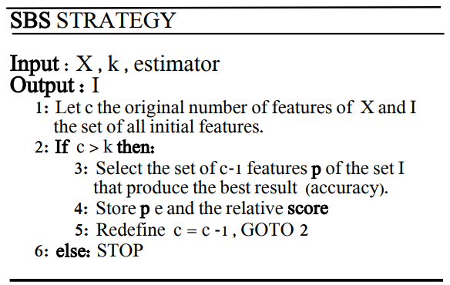
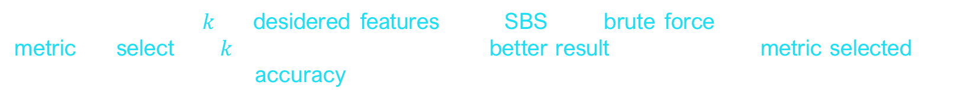
SBS (Sequential Backward Selection)
The SBS is a selection technique for dimensionality reduction. This mean that at the end of the process the data are represented by the same features , with the difference that the number of features selected should be lower than the initial one.
Fixed the number $k$ of desidered features , the SBS is a brute force method. Infact , fixed a metric , it select the $k$ features that give us the better result in term of the metric selected , for example in our case the accuracy.
In the sequel , the SBS algorithm.
As we can see , it taken as input the X dataset , the k features and the estimator , and outputs the set I of features selected.
Remeber , as said before , that with SBS we don’t change the features representing the data.

Slide 23
Now is the moment to apply the SBS strategy to the Red Wine Quality Prediction Problem. In particular we have selected $k=6.$
# ottimizzazione indici
while nC > self.k_f:
# memorizzazione score per ogni sottoinsieme di indici
scores = []
sottoIns = []
# presa in considerazione di tutte le combinazioni di nC - 1 indici
for p in combinations(self.indici,r = nC - 1):
# valutazione modello su sottoinsieme p di caratteristiche
scoreModello = self.valutaIndici(X_train,X_test,y_train,y_test,p)
# memorizzazione sottoinsieme di indici e score
scores.append(scoreModello)
sottoIns.append(p)
# selezione sottoinsieme ottimale
indiceBest = np.argmax(scores)
self.indici = sottoIns[indiceBest]
self.sottoIns.append(self.indici)
self.scores.append(scores[indiceBest])
# aggiornamento
nC = nC - 1

Slide 24
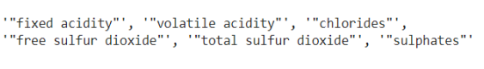
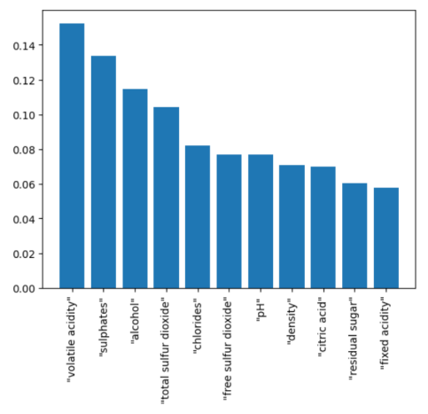
The application of the SBS strategy return us the following set of the six important features , that give us the best result in term of accuracy.
There is a method on the Random Forest technique that return us the most important features in term of the mean inpurity calculated by a set of decision tree classifier.
And it is important to note how the features selected by SBS are the best features in term of mean inpurity returned by the Random Forest classifier.
Classifier | Training Accuracy | Validation Accuracy
SVM | SBS | 0,96 | 0,95
SVM | 0,99 | 0,95

Slide 25
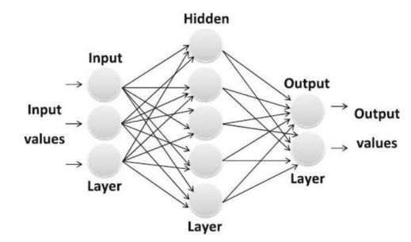
MLP (Multilayer Perceptron)
After done the dimensionality reduction , we can try to train a multilayer neural network for classification purpose.

Slide 26
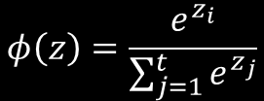
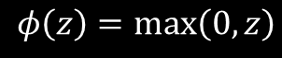
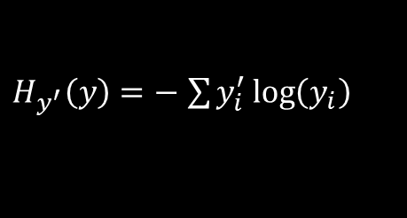
We’ll train a multilayer perceptron with only an hidden layer. Because for this kind of problem it result sufficient. The hidden layer is composed by 8 neurons.
The output layer is characterized by 3 neurons according to the One-Hot encoding technique.
As activation function for the hidden layer we have used the ReLU function and the Softmax function for the output layer.
$$φ\left(z\right)=\frac{e^{z_{i}}}{\sum_{j=1}^{t}{e^{z_{j}}}}$$
$$φ\left(z\right)=\max\left(0,z\right)$$
$H_{y^{′}}\left(y\right)=−$ $\sum{y_{i}^{′}\log\left(y_{i}\right)}$
Note we have used the cross-entropy as cost function..

Slide 27
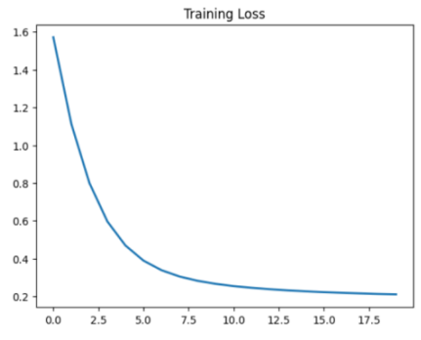
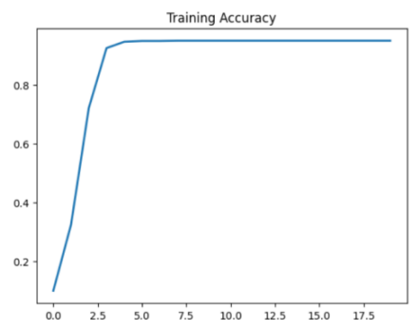
Training Loss | Training Accuracy | Loss Validation | Validation Accuracy
0,2108 | 0,9491 | 0,2630 | 0,95

Slide 28
References
[1] S. Kumar , K. Agrawal , N. Mandan , “Red Wine Quality Prediction Using Machine Learning Techniques”, (ICCCI -2020)
[2] K. R. Dahal , J. N. Dahal , H. Banjade , S. Gaire “Prediction of Wine Quality Using Machine Learning Algorithms” , Open Journal of Statistics, 2021, 11, 278-289
[3] Y. Gupta “Selection of Important Features and Predicting Wine Quality using machine learning techniques” , ICSCC -2017.

